Slide 1
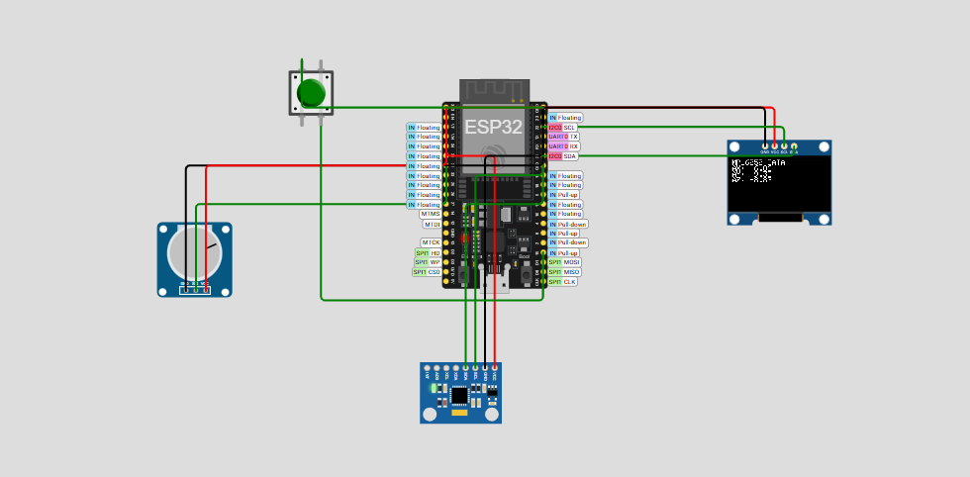
Simulation Diagram Details :
ESP32 Driver Board
Monochrome 128x64 OLED display with I2C interface
PUSH BUTTON
Knob-controlled variable resistor (linear potentiometer)
Integrated sensor with 3-axis accelerometer, 3-axis gyroscope and a temperature sensor with I2C interface.

Slide 2
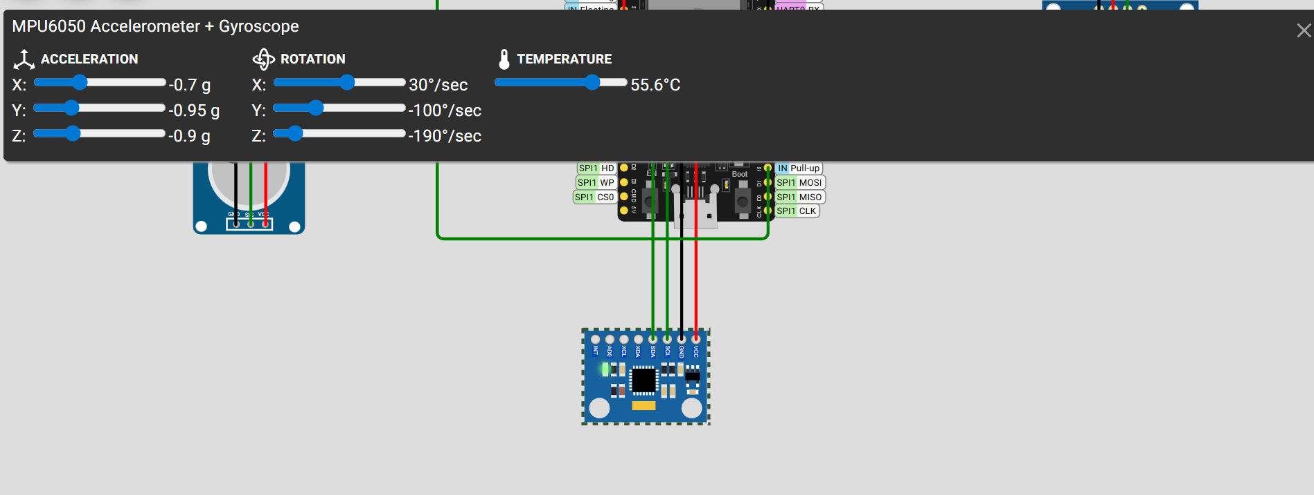
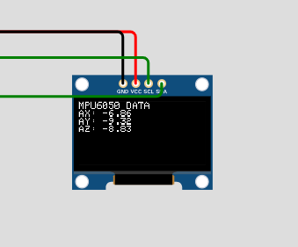
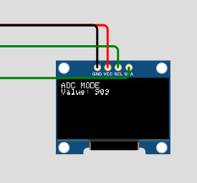
MPU6050 Accelerometer+ Gyroscope
LCD output:
LCD output

